Slide 1

The lecture 5
The probability theory

Slide 2
Content
Language Models
  What are N-gram models?
How to use probabilities
  What does P(Y|X) mean?
  How can I manipulate it?
  How can I estimate its value in practice?

Slide 3
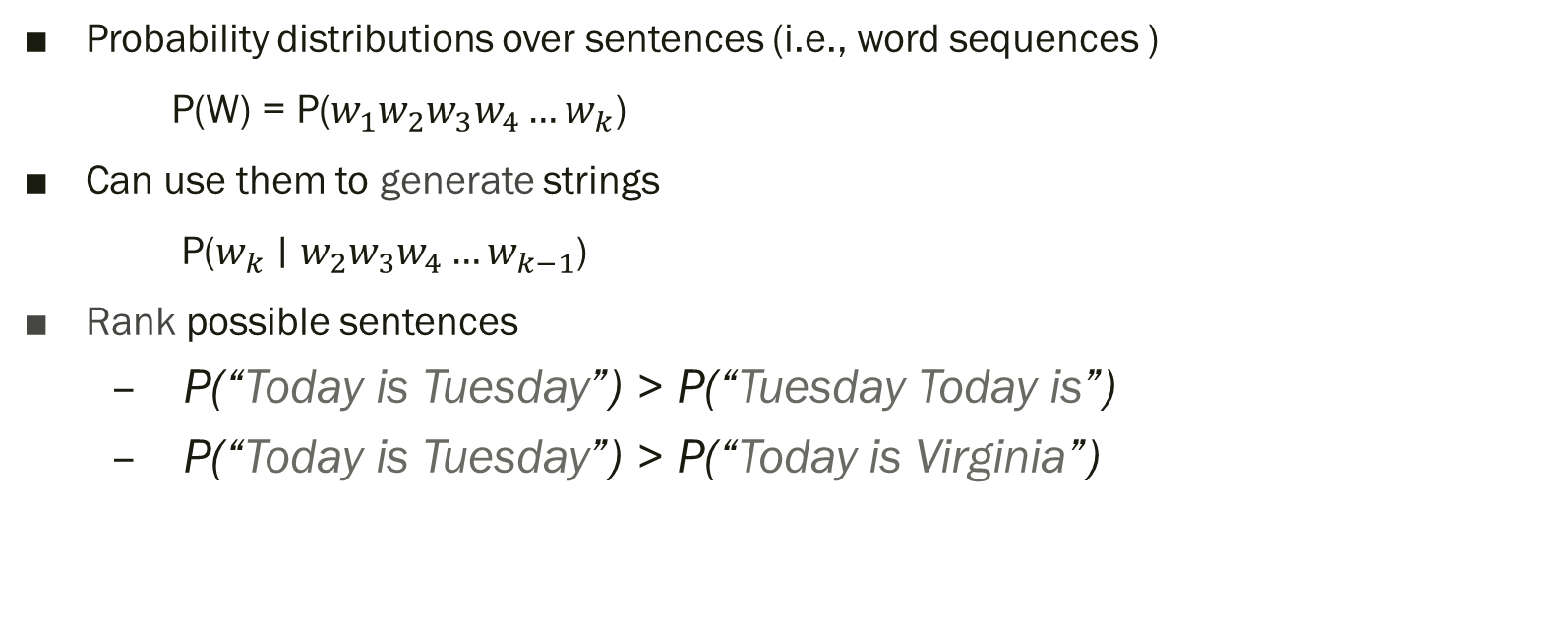
What is a language model?
Probability distributions over sentences (i.e., word sequences )
P(W) = P($w_{1}w_{2}w_{3}w_{4}…w_{k}$)
Can use them to generate strings
P($w_{k}∣w_{2}w_{3}w_{4}…w_{k−1}$)
Rank possible sentences
  P(“Today is Tuesday”) > P(“Tuesday Today is”)
  P(“Today is Tuesday”) > P(“Today is Virginia”)

Slide 4

Language model applications
Smart Reply

Slide 5
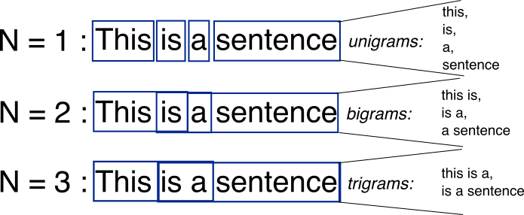
Bag-of-Words with N-grams
N-grams: a contiguous sequence of n tokens from a given piece of text

Slide 6
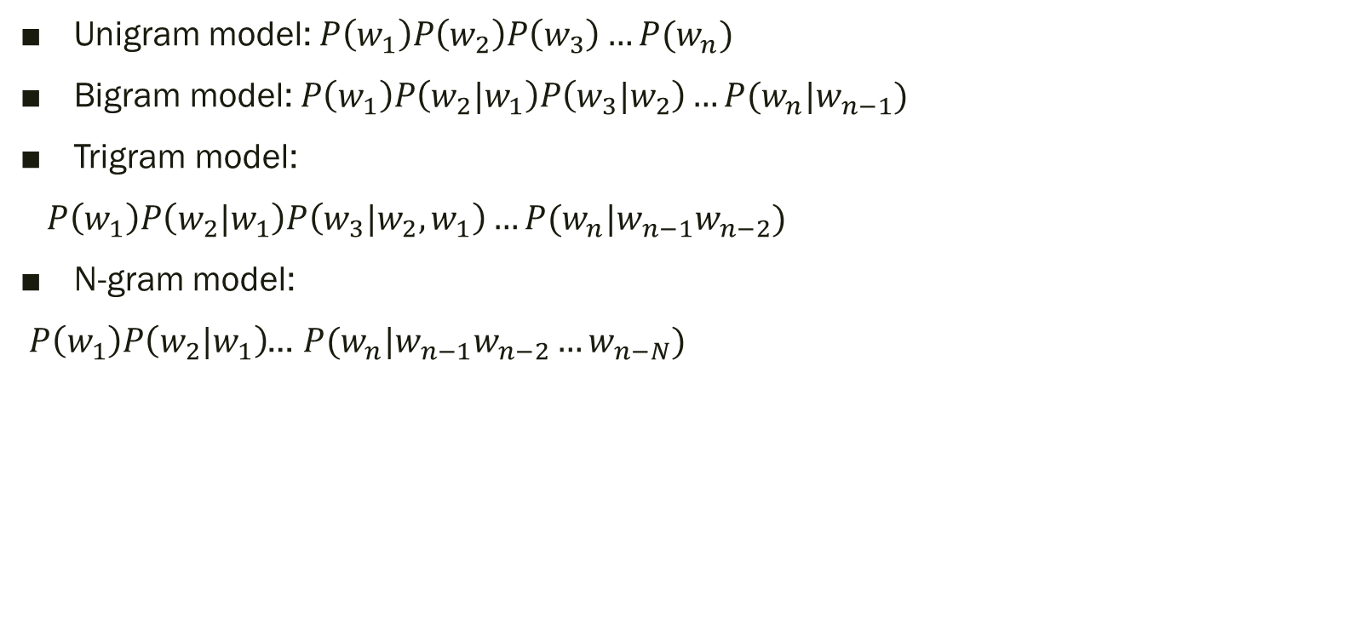
N-Gram Models
Unigram model: $P\left(w_{1}\right)P\left(w_{2}\right)P\left(w_{3}\right)…P(w_{n})$
Bigram model: $P\left(w_{1}\right)P\left(w_{2}|w_{1}\right)P\left(w_{3}|w_{2}\right)…P(w_{n}|w_{n−1})$
Trigram model:
$P\left(w_{1}\right)P\left(w_{2}|w_{1}\right)P\left(w_{3}|w_{2},w_{1}\right)…P(w_{n}|w_{n−1}w_{n−2})$
N-gram model:
$P\left(w_{1}\right)P\left(w_{2}|w_{1}\right)$… $P(w_{n}|w_{n−1}w_{n−2}…w_{n−N})$

Slide 7
Sampling words with replacement

Slide 8
Conditional on the previous word

Slide 9
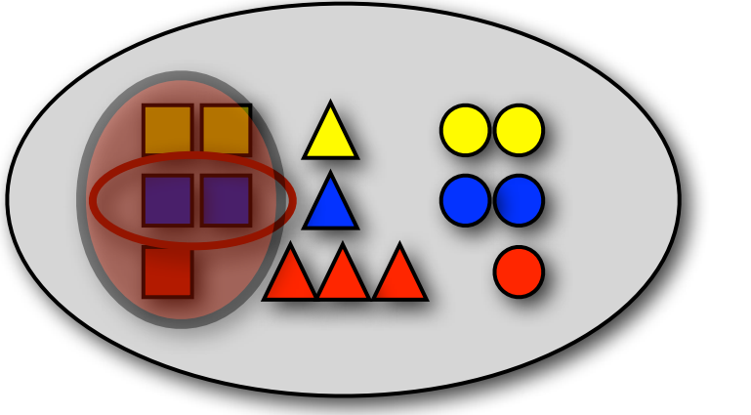

Recap: probability Theory
Conditional probability
P(blue | □) = ?
$P\left(B ∣ A\right)=P(B,A)/P(A)$
Bayes’ rule: $P\left(B ∣ A\right)=\frac{P(A|B)P\left(B\right)}{P(A)}$
  Verify: P(red | □) , P(□ | red ), P(□), P(red)
Independent $P\left(B ∣ A\right)=P(B)$
  Prove: $P\left(A,B\right)=P\left(A\right)P(B)$

Slide 10
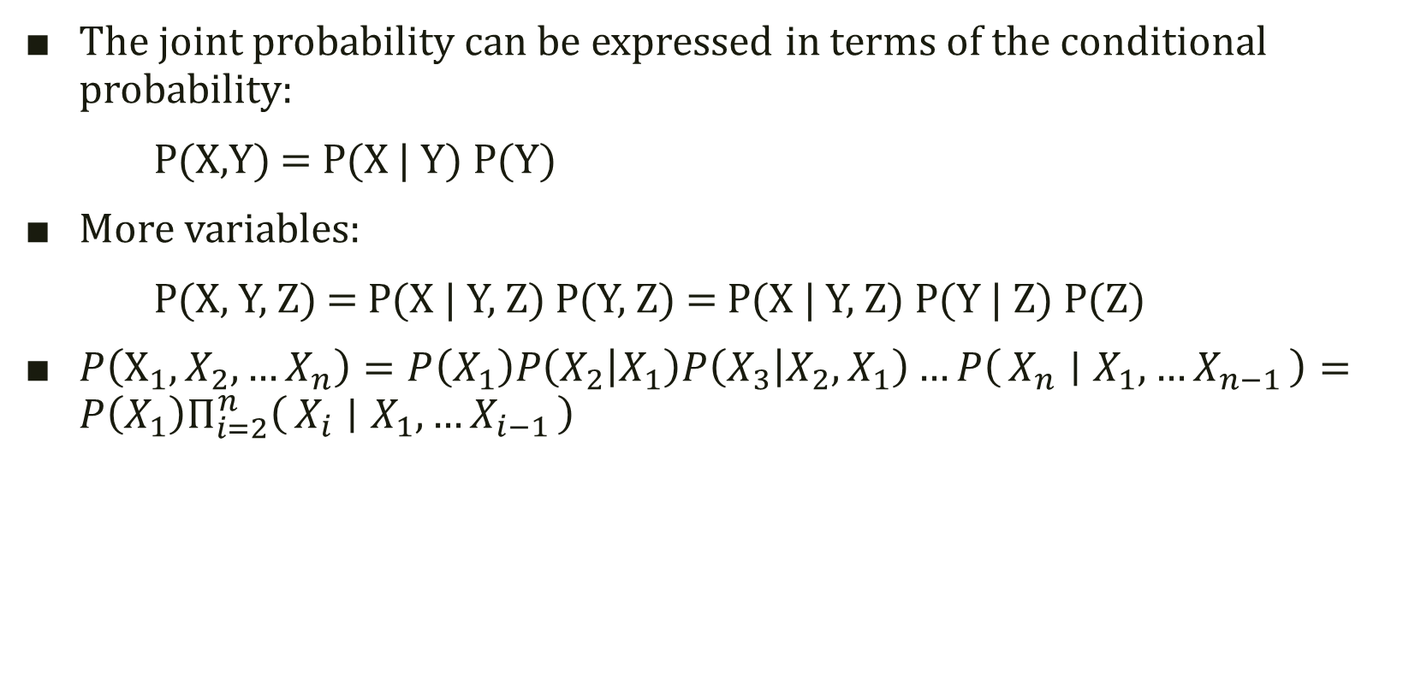
The Chain Rule
The joint probability can be expressed in terms of the conditional probability:
P(X,Y) = P(X | Y) P(Y)
More variables:
P(X, Y, Z) = P(X | Y, Z) P(Y, Z) = P(X | Y, Z) P(Y | Z) P(Z)
$P\left(X_{1},X_{2},…X_{n}\right)=P\left(X_{1}\right)P\left(X_{2} | X_{1}\right)P\left(X_{3} | X_{2},X_{1}\right)…P\left(X_{n} ∣ X_{1},…X_{n−1}\right)=P\left(X_{1}\right)Π_{i=2}^{n}\left(X_{i} ∣ X_{1},…X_{i−1}\right)$

Slide 11
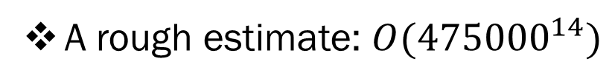

Language model for text
We need independence assumptions!
Probability distribution over sentences
  $p\left(w1 w2 … wn\right)=p\left(w1\right)p\left(w_{2} | w_{1}\right)p\left(w_{3} | w_{1},w_{2}\right)…p\left(w_{n} | w_{1},w_{2},…,w_{n−1}\right)$
  Complexity - $O(V^{n^{∗}})$
    $n^{∗}$ - maximum sentence length
Chain rule: from conditional probability to joint probability
475,000 main headwords in Webster's Third New International Dictionary
Average English sentence length is 14.3 words
A rough estimate: $O({475000}^{14})$

Slide 12
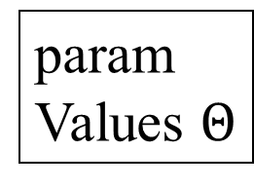
Probability models
Building a probability model:
  defining the model
  (making independent assumption)
  estimating the model’s parameters
  use the model (making inference)
Trigram Model
(defined in terms of parameters like P(“is”|”today”) )
param
Values $Θ$
definition
of P

Slide 13

Language model with N-gram
The chain rule:
$$P\left(X_{1},X_{2},…X_{n}\right)=P\left(X_{1}\right)P\left(X_{2} | X_{1}\right)P\left(X_{3} | X_{2},X_{1}\right)…P\left(X_{n} ∣ X_{1},…X_{n−1}\right)$$
N-gram language model assumes each word depends only on the last n-1 words (Markov assumption)

Slide 14

Language model with N-gram
Example: trigram (3-gram)
$P\left(w_{n} ∣ w_{1},…w_{n−1}\right)$ = $P\left(w_{n} ∣ w_{n−2},w_{n−1}\right)$
$P(w_{1}, …w_{n})$=
P$\left(w_{1}\right)P\left(w_{2} | w_{1}\right)…P\left(w_{n} ∣ w_{n−2},w_{n−1}\right)$
$P\left("Today is a sunny day"\right)$
$=$P(“Today”)P(“is”|”Today”)P(“a”|”is”, “Today”)…P(“day”|”sunny”, “a”)

Slide 15
Unigram model

Slide 16
Bigram model
Condition on the previous word

Slide 17
Ngram model

